Slide 1
Introduction to Web Programming
Lecture 11: Introduction to JavaScript (Part 4)
Natheer Gharaibeh

Slide 2
Outlines of today’s lecture
•
Events
•
Assigning events using DOM
•
Dom nodes
•
Browser Object Model (BOM)

Slide 3
concepts
In computer programming, event-driven programming is a programming paradigm in which the flow of the program is determined by events such as user actions (mouse clicks, key presses), sensor outputs, or messages from other programs or threads. Event-driven programming is the dominant paradigm used in graphical user interfaces and other applications (e.g., JavaScript web applications) that are centered on performing certain actions in response to user input. This is also true of programming for device drivers (e.g., P in USB device driver stacks^{[1]}).

Slide 4
HTML events
HTML events are "things" that happen to HTML elements.
An HTML event can be something the browser does, or something a user does.
Here are some examples of HTML events:
An HTML web page has finished loading
An HTML input field was changed
An HTML button was clicked
Often, when events happen, you may want to do something.
JavaScript lets you execute code when events are detected.
HTML allows event handler attributes, with JavaScript code, to be added to HTML elements.

Slide 5
Event Attributes
Attribute | The event occurs when...
onchange | The content of a ﬁeld changes
onclick | Mouse clicks an object
ondblclick | Mouse double6clicks an object
onerror | An error occurs when loading a document or an image
onload | A page or image is ﬁnished loading
onmouseout | The mouse is moved oﬀ an element
onmouseover | The mouse is moved over an element
oerror

Slide 6
onchange Event
The onchange event occurs when the content of a field changes.
often used in combination with validation of input fields
<html>
<head>
<script type="text/javascript">
function upperCase(x)
{
var y=document.getElementById(x).value; document.getElementById(x).value=y.toUpperCase();
}
</script>
</head>
<body>
Enter your name:
<input type="text" id="fname" onchange= "upperCase(this.id)" />
</body>
</html>

Slide 7
onclick Event
The onclick event occurs when an object gets clicked.
<html>
<body>
Field1: <input type="text" id="field1" value="Hello World!" />
<br />
Field2: <input type="text" id="field2" />
<br /><br />
Click the button to copy the content of Field1 to Field2.
<br />
<button onclick="document.getElementById('field2').value=document.getE lementById('field1').value">Copy Text</button>
</body>
</html>

Slide 8
ondbclick Event
The ondblclick event occurs when an object gets double-clicked.
<html>
<body>
Field1: <input type="text" id="ﬁeld1" value="Hello World!" />
<br />
Field2: <input type="text" id="ﬁeld2" />
<br /><br />
Double Click the button to copy the content of Field1 to Field2.
<br />
<button ondblclick="document.getElementById('ﬁeld2').value=document.get ElementById('ﬁeld1').value">Copy Text</button>
</body>
</html>

Slide 9
onerror Event
The onerror event is triggered when an error occurs with an element.
<html>
<body>
<img src="image.gif" onerror="alert('The image could not be loaded.')" />
<p>In this example we refer to an image that does not exist, therefore we will get the alert box.</p>
</body>
</html>

Slide 10
onload Event
The onload event occurs immediately after a page or an image is loaded.
<html>
<head>
<script type="text/javascript">
function load()
{
alert("Page is loaded");
}
</script>
</head>
<body onload="load()">
<h1>Hello World!</h1>
</body>
</html>

Slide 11
onmouseover and onmouseout Events
The onmouseover event occurs when the mouse pointer moves over a specified object.
The onmouseout event occurs when the mouse pointer moves away from a specified object.
<html>
<body>
<img src="image_w3default.gif" name="mousetest" onMouseOver="document.images['mousetest'].src='image_w3def ault2.gif'" onMouseOut="document.images['mousetest'].src='image_w3defa ult.gif'" width="234" height="91" />
</body>
</html>

Slide 12
Assigning Events Using DOM
The HTML DOM allows you to assign events to HTML elements using JavaScript:
Assign an onclick event to a button element:
<script>
document.getElementById("myBtn").onclick = function(){ displayDate() };
</script>

Slide 13
Checkbox checked attribute
<html>
<head>
<script type="text/javascript">
function check() { document.getElementById("check1").checked=true; } function uncheck() { document.getElementById("check1").checked=false;}
</script>
</head>
<body>
<form>
<input type="checkbox" id="check1" />Do you like summer?
<input type="button" value="Check Checkbox" onclick="check()" / >
<input type="button" value="Uncheck Checkbox" onclick="uncheck()" / >
</form>
</body>
</html>

Slide 14
Radio Button value and checked attributes
<html>
<head>
<script type="text/javascript">
function showFun()
{
var x=""; if(document.getElementById("r1").checked==true) x=document.getElementById("r1").value;
else if(document.getElementById("r2").checked==true) x=document.getElementById("r2").value;
alert(x);
}
</script>
</head>
<body>
Gender:<br/>
<input type="radio" name="gender" value="Male" id="r1" /> Male <br/>
<input type="radio" name="gender" value="Female" id="r2" /> Female <br/>
<input type="button" value="show gender" onclick="showFun()"/>
</body>
</html>
12

Slide 15
Select selectedIndex Property
<html> <head>
<script type="text/javascript">
function displayResult()
{
var y=document.getElementById("car").options;
var x=document.getElementById("car").selectedIndex; alert("x= " + x + " y[" + x + "]= " + y[x].value);
}
</script> </head>
<body>
Select your Car:<br />
<select id="car">
<option value ="Kia"> KIA </option>
<option value ="bmw"> BMW </option>
<option value ="jaguar"> JAGUAR </option>
<option value ="golf"> GOLF </option>
</select>
<input type="button" value="showCar" onclick="displayResult()">
</body> </html>

Slide 16
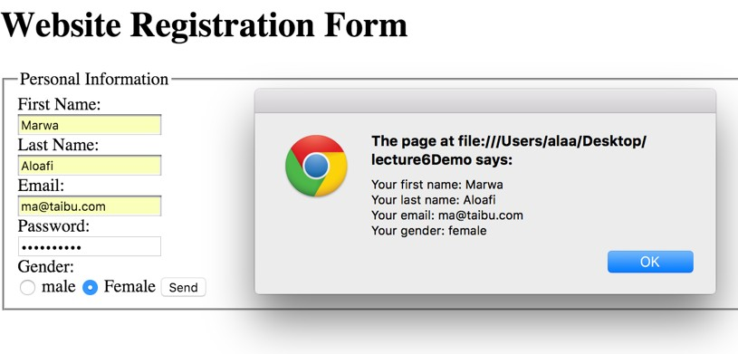
Demo!

Slide 17
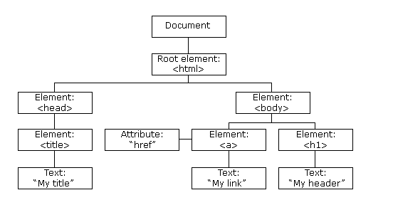
DOM Nodes
According to the W3C HTML DOM standard, everything in an HTML document is a node:
The entire document is a document node
Every HTML element is an element node
The text inside HTML elements are text nodes
Every HTML attribute is an attribute node
All comments are comment nodes

Slide 18
Navigating Between Nodes
You can use the following node properties to navigate between nodes with JavaScript:
parentNode
childNodes[nodenumber]
firstChild
lastChild
nextSibling
previousSibling

Slide 19
Node Properties–Examples
In addition to the innerHTML property, you can also use the childNodes and nodeValue properties to get the content of an element.
<html>
<body>
<h1 id="intro">My First Page</h1>
<p id="demo">Hello!</p>
<script>
var myText = document.getElementById("intro").childNodes[0].nodeValue; document.getElementById("demo").innerHTML = myText;
</script>
</body>
</html>

Slide 20
Node Properties–Examples
Using the firstChild property is the same as using childNodes[0]:
<html>
<body>
<h1 id="intro">My First Page</h1>
<p id="demo">Hello World!</p>
<script> myText =
document.getElementById("intro").firstChild.nodeValue; document.getElementById("demo").innerHTML = myText;
</script>
</body>
</html>

Slide 21
The Browser Object Model (BOM)
The Browser Object Model (BOM) is a collection of objects that give you access to the browser and the computer screen. These objects are accessible through the global object window
The window object is supported by all browsers. It represents the browser's window.
There's a window object for every frame, iframe, pop up, or browser tab.
All global JavaScript objects, functions, and variables automatically become members of the window object.

Slide 22
The setTimeout() Method
Syntax
•window.setTimeout("javascript function", milliseconds);
•The window.setTimeout() method can be written without the window prefix.
•The setTimeout() method will wait the specified number of milliseconds, and then execute the specified function.
•The first parameter of setTimeout() should be a function.
•The second parameter indicates how many milliseconds, from now, you want to execute the first parameter.
Example
Click a button. Wait 3 seconds. The page will alert "Hello":
<button onclick = "setTimeout(function(){alert('Hello')}, 3000)">Try it</button>

Slide 23
The setInterval () Method
• The setInterval() method will wait a specified number of milliseconds, and then execute a specified function, and it will continue to execute the function, once at every given time-interval.
Syntax
window.setInterval("javascript function", milliseconds);
• The window.setInterval() method can be written without the window prefix.
• The first parameter of setInterval() should be a function.
• The second parameter indicates the length of the time- intervals between each execution.
• Note: There are 1000 milliseconds in one second.
•Example
Alert "hello" every 3 seconds:
setInterval(function () {alert("Hello")}, 3000);

Slide 24
References
www.w3schools.com
Stefanov, S. (2013). Object-Oriented JavaScript. Packt Publishing Ltd.
Deitel & Deitel (2011). Internet and World Wide Web How to Program, 5th Edition, Harvey & Paul Deitel & Associates.

